Slide 1

Pi in the Sky
Using Wavefront to Analyze Pi-Hole Data [VMTN5013U]
Nick Korte
Solution Engineer, VMware (@NetworkNerd_)
Notes:
Photo credit: pixabay

Slide 2
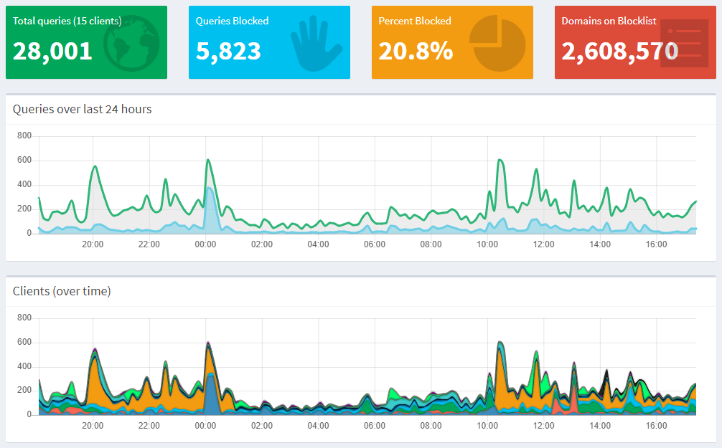

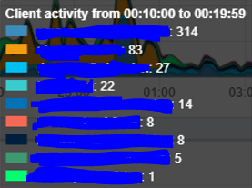
Inside the Pi-hole Interface
Notes:
Moving window of queries and queries by client, counts every 10 minutes – moves if you leave the interface open
Charts present:
-Query types
-Queries answered by (DNS)
-Top Permitted / Blocked Domains
-Top Clients by requests
-Top Clients by requests blocked
Top – total DNS queries and show blocked DNS queries in blue

Slide 3
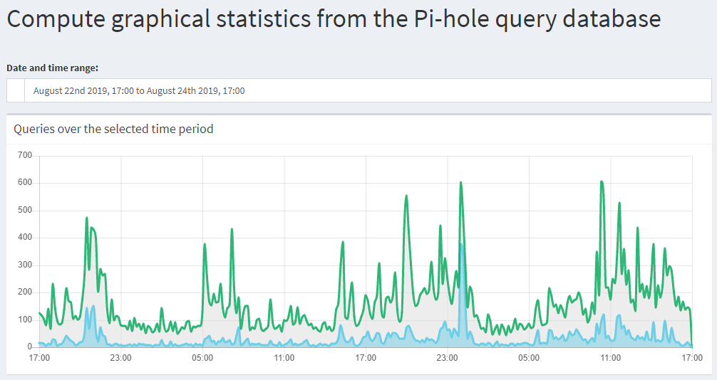

Customizations are Useful
Notes:
Static window of inspection
Still see query totals with number of blocked DNS queries
Data points every ten minutes

Slide 4
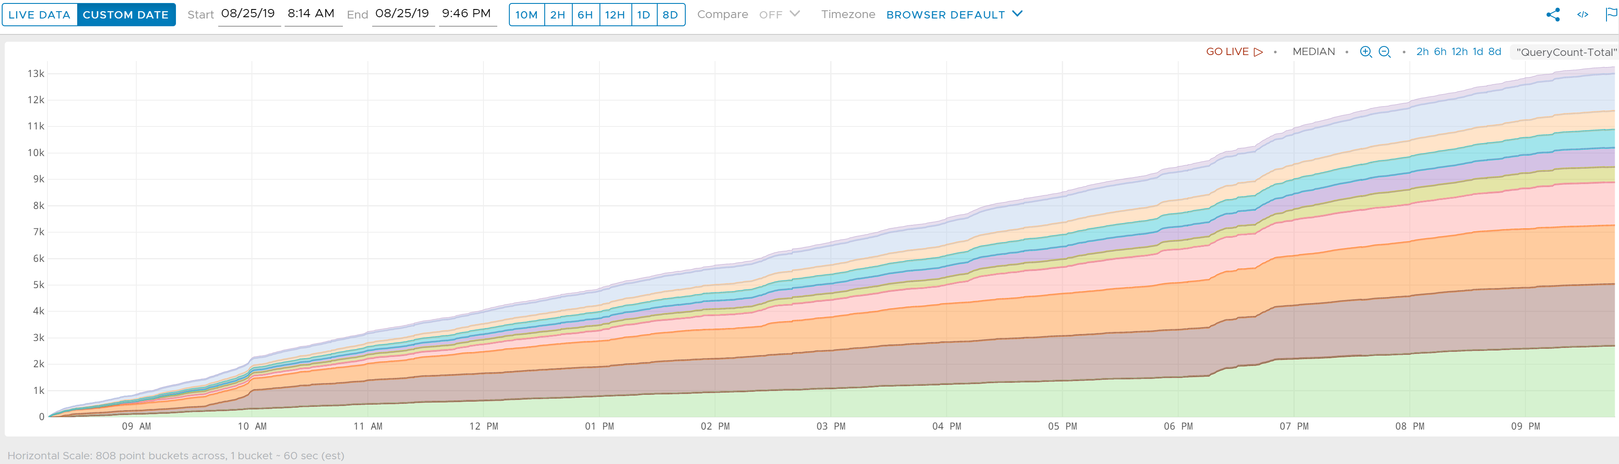
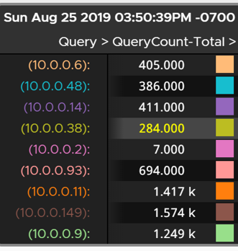
Enhanced Visibility in Wavefront
Notes:
Median query count per device
Address bucketing – many queries per second at times
Difference in count between different times
Specific time interval, exact chart of representation

Slide 5
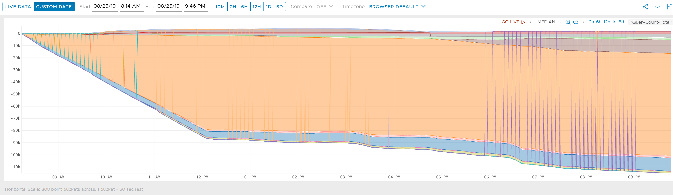
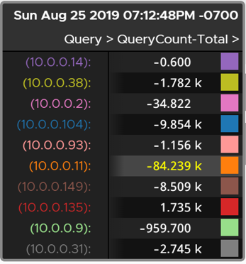
Enhanced Visibility in Wavefront
Notes:
What about the rough difference between current query count total and 24 hours ago?
Do I have more traffic now or before (definitely more yesterday)
Point plot, line plot, etc.

Slide 6



Where Did This Begin?
Conversation with a co-worker
Raspberry Pi 3B+
Installed Pi-hole
DHCP Reconfig
Notes:
Aaron and I had talked about sending logs from the Pi / Pi-hole to LogInsight
As for me…
Bought the CanaKit
Installed Raspbian

Slide 7

I Wanted to Learn Wavefront
It’s in the cloud
A time-series metrics analysis engine
Counters
Gauges
Histograms
Delta Counters
Traces
Spans
Rollup is a non-issue
Notes:
Wavefront = completely SaaS, designed with applications and microservices in mind
Time series metrics
No data rollup
Made for many points per second
Metrics – some assembly required
-Counter – increment / decrement
-Gauge – specific value at a point in time
-Histogram – high volume data ingestion (compute, store, use distributions of metrics – i.e. 95th / 99th percentile)
-Delta Counter – suited for bursty traffic like functions as a service (FaaS) – aggregate multiple values and store result
-Trace – represents a workflows (i.e. how did my request propagate through microservices), consists of one or more span
-Span – time spent by an operation in a service

Slide 8
Getting Data to Wavefront
No integration for Pi-hole
Two Paths for metric ingestion
Direct
Wavefront data format only
Using a Proxy
Wavefront data format
Graphite data format
OpenTSDB data format
Supports Log Ingestion
Notes:
Wavefront has integrations with cloud providers, dev tools, and many other things
Direct Ingestion Limitations
No disk queueing
No rate limiting
No blacklist or whitelist
No preprocessor
Only Wavefront data format is currently supported. No support for OpenTSB, JSON, and Pickle
No support for log ingestion
Proxy can run Linux, Mac, Windows, or in a Docker / Kubernetes container

Slide 9
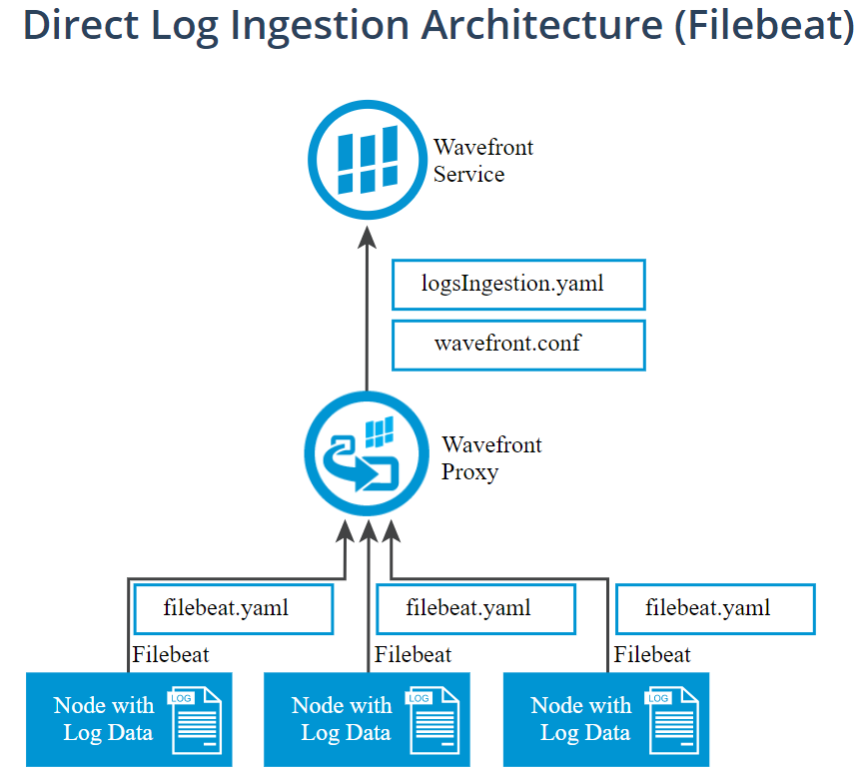
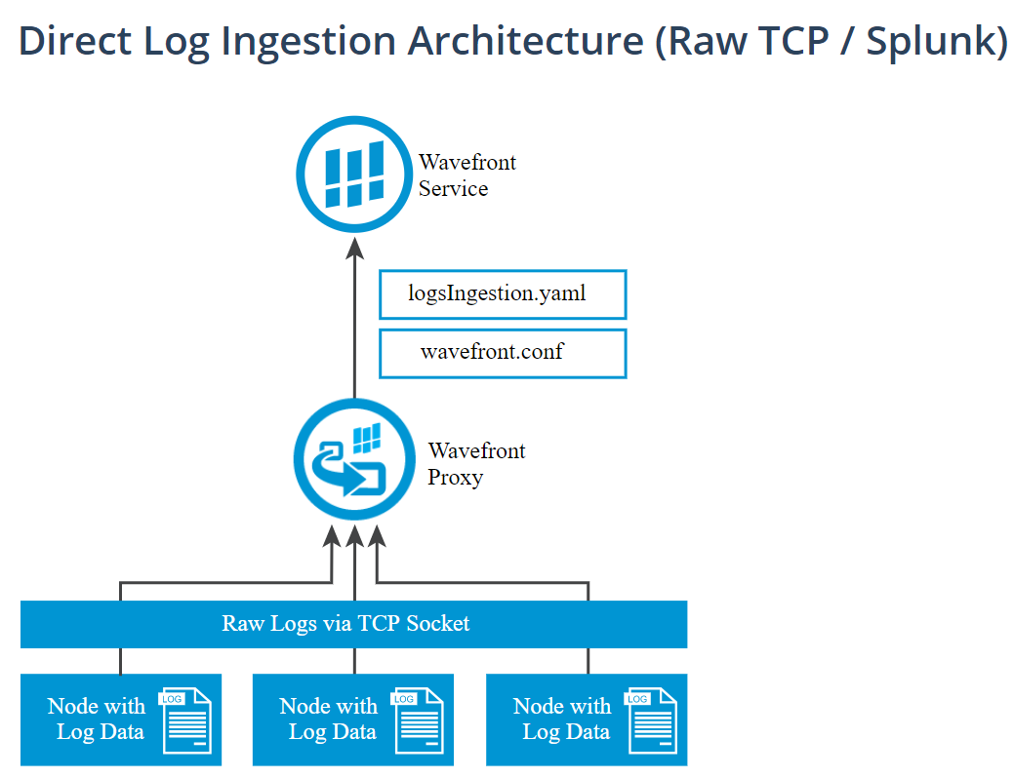
Log Shipping
Proxy Supported Methods
Filebeat
Not supported on ARM
Raw TCP
Splunk tooling?
Rsyslog
Syslog-ng
Metrics Supported
Counters, gauges, histograms
Notes:
Filebeat – part of the Elastic stack, used to ship logs
People had compiled Filebeat on ARM…did not want to go there
Filebeat port, raw TCP port
Splunk had a free tool…behind a registration
Lessons
-Rsyslog already part of Raspbian
-Syslog-ng looked like the better tool

Slide 10


Proxy Placement?
Wavefront proxy on the Raspberry Pi
Not supported
Wavefront proxy on a Windows box at home
Wife’s computer?
AWS EC2 Free Tier
Thank You Bill Roth!
Notes:
Proxy can run Linux, Mac, Windows, or in a Docker / Kubernetes container

Slide 11


The To-Do List
Deploy Proxy
VM + wavefront-proxy service
Sync with Wavefront instance
Ship Logs
Install and config syslog-ng
Configure proxy to accept
Verify Receipt
Clear the path
Internal metrics
Notes:
Deploy
-Not a Ubuntu expert
-The service is a simple install and is open source
Ship Logs
-Linux man pages for syslog-ng
-Started with just pi-hole.log
-Wavefront.conf file on the proxy
Verify Logs
-Had to tweak AWS security groups
-Had to check Ubuntu

Slide 12
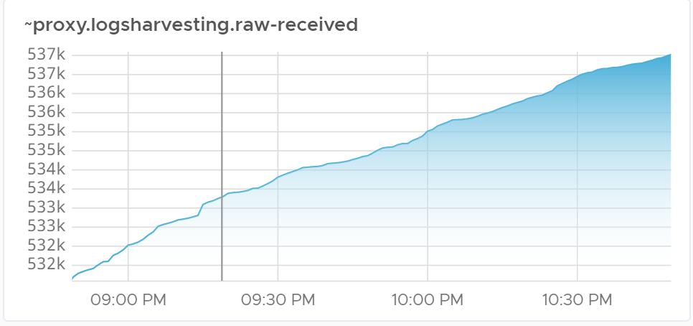
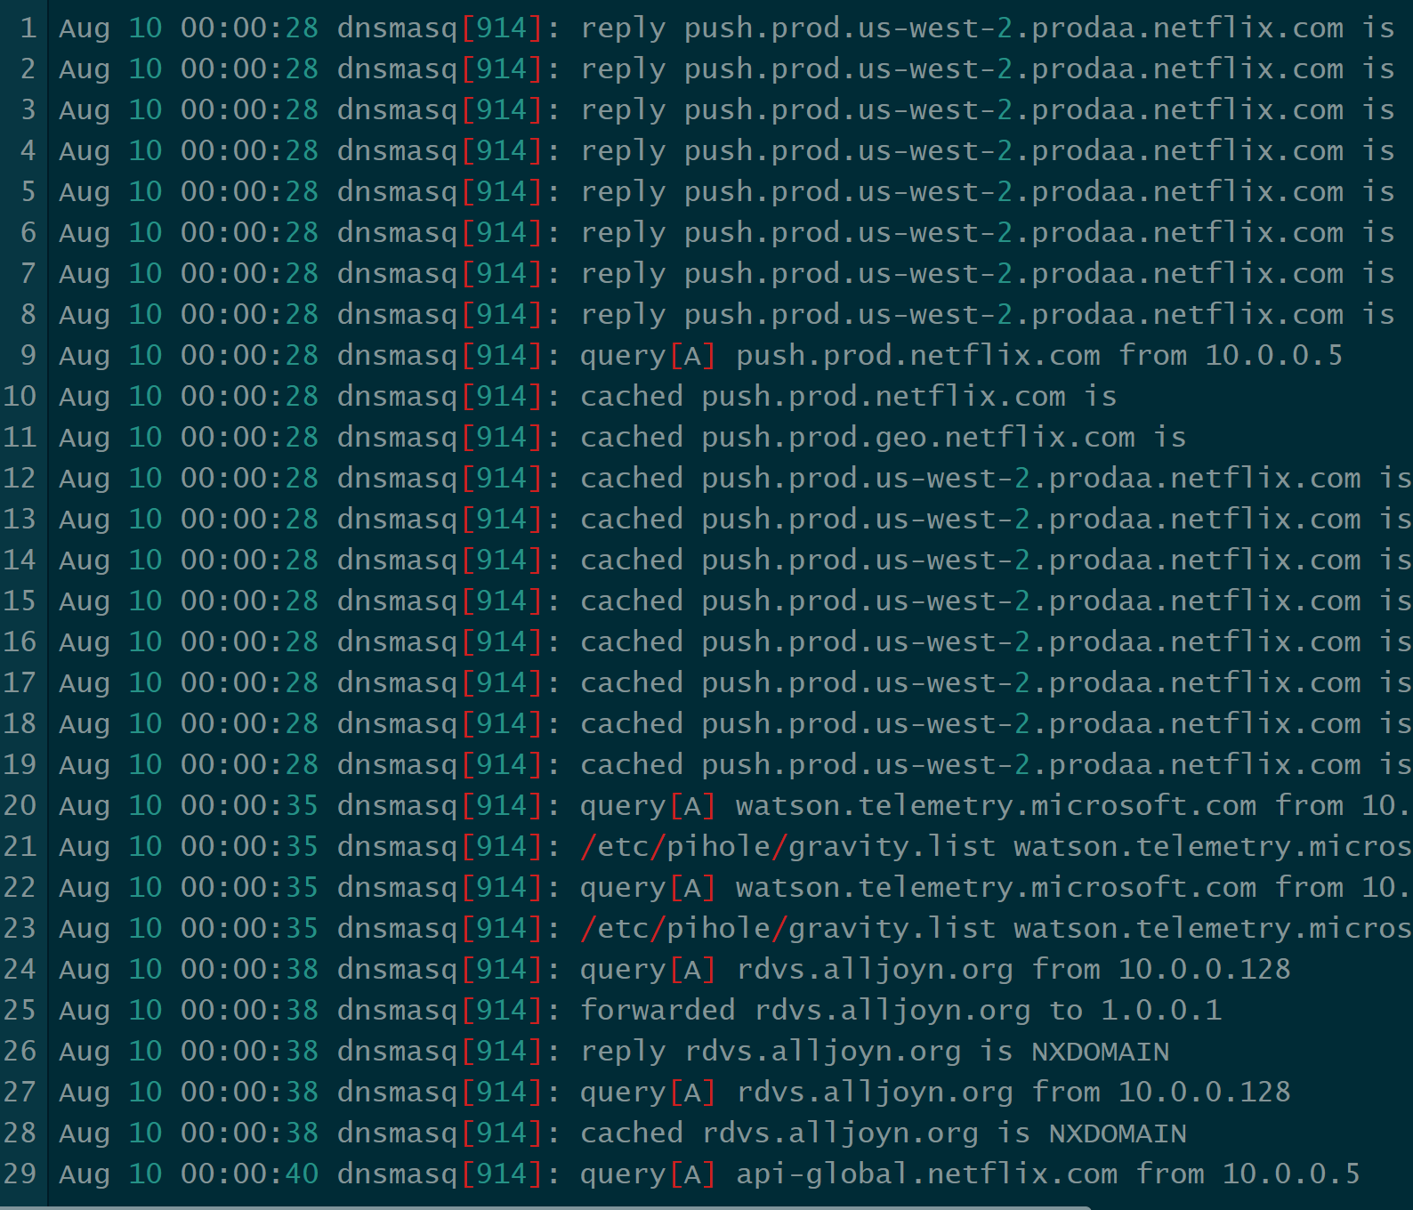
Proxy Config and Grok Patterns
No metrics yet!
Grok patterns are
For parsing unstructured log data
Logstash filter
Ideas for metrics…
Query count per device
Query blocks per device
Cache hits
Response time of domain
Notes:
Only verified logs received by proxy (only pihole.log)
There is a grok pattern filter you can use in Logstash (dataflow engine for Elastic Stack – send log data to it regardless of format)
Pull out important information
Counter, gauge, histogram

Slide 13

Grok and logsIngestion.yaml
Sample log line
Aug 10 00:00:28 dnsmasq[914]: query[A] push.prod.netflix.com from 10.0.0.5
Sample grok pattern
\[%{NUMBER}\]\: %{WORD:RequestType}\[%{WORD}\] %{HOST:Domain} %{WORD} %{IP:DeviceAddress}
Important information captured
RequestType = query
Domain = push.prod.netflix.com
DeviceAddress = 10.0.0.5
Notes:
All grok patterns contained in logsIngestion.yaml – on the Wavefront proxy
Grok patterns describe a data format
Need yours to be unique to match a specific line
I match, parse out data I want

Slide 14
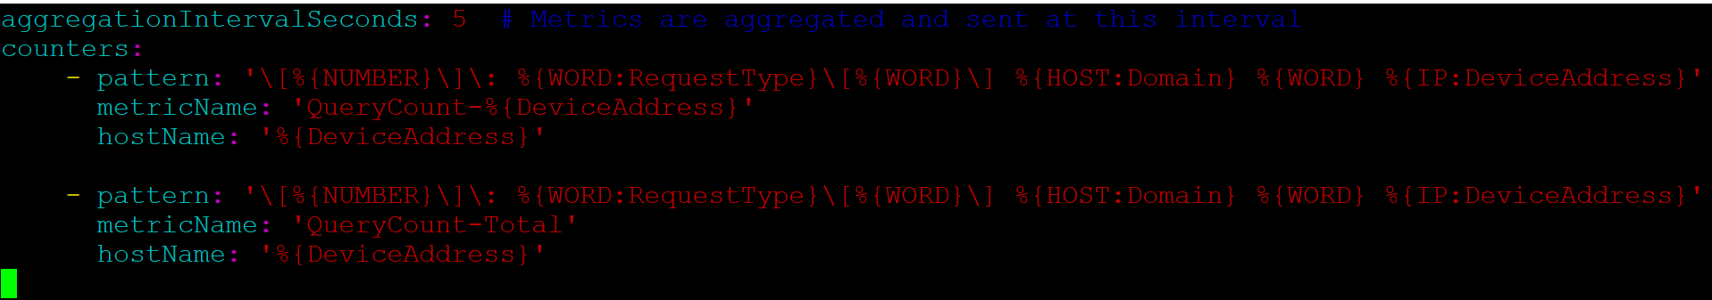
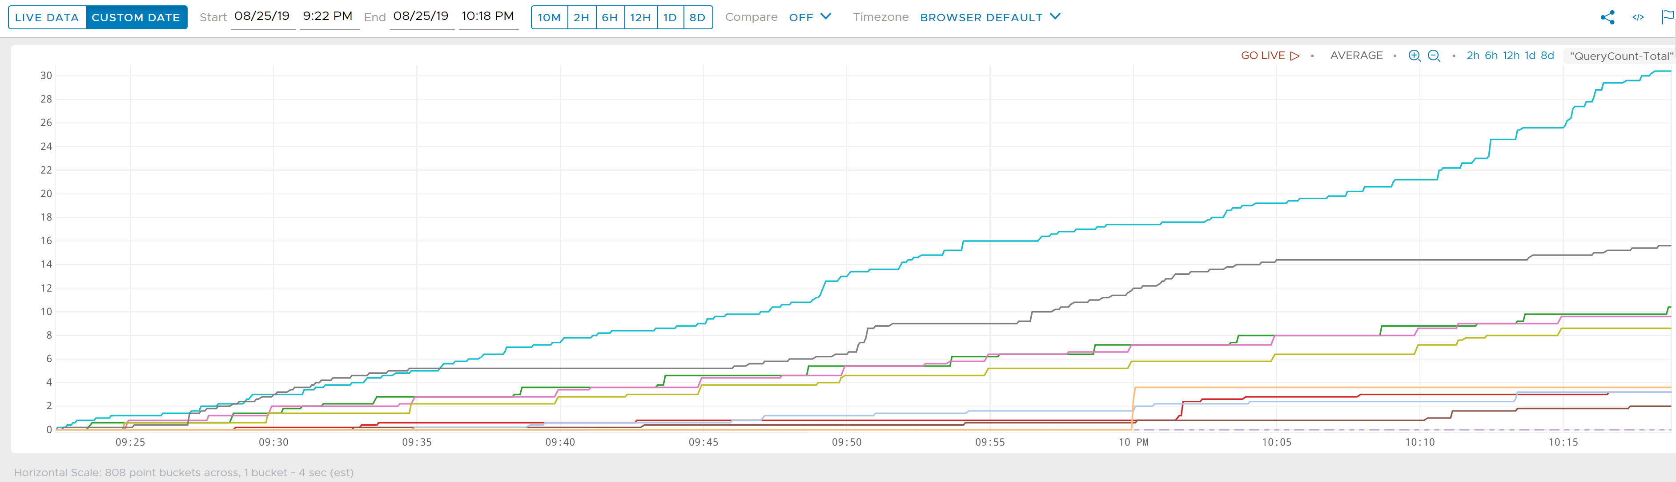
Example of logsIngestion.yaml
Notes:
Graph shows QueryCount-Total
Data time stamped once it enters Wavefront from the proxy

Slide 15
What Comes Next…Maybe?
Dashboards for Pi-hole
Automation of proxy deployment with other tools
Play with histograms
WQL tutorials?
Notes:
WQL = Wavefront Query Language

Slide 16
Suppplemental Information
Official Wavefront Blog
Wavefront Public Slack
Search the HOL Catalog for Wavefront
HOL-1902-01-CMP
Try Wavefront for Free - 30-day Trial Link
Wavefront Metrics
Wavefront Proxies
Wavefront Direct Data Ingestion
Wavefront Data Format
Wavefront Log Data Metrics Ingestion

Slide 17
The Journey Contines
Part 1 – Creating a Wavefront Proxy in AWS
Part 2 – Shipping Pi-hole Logs to a Wavefront Proxy
Part 3 – Verifying Wavefront Proxy Log Ingestion
Part 4 – Fishing for Wavefront Metrics with Grok Patterns
Part 5 – Coming soon!
Check these out at blog.thenetworknerd.com
Find me on Twitter: @NetworkNerd_

